Slide 1
Standardization

Slide 2
Overview
Multilang
Javascript
ADO.NET / EDMX
POCO
Transaction
Latihan
Test

Slide 3

Multilang
You can use one,two, or more, different languages in an a project and you can use assemblies created from different languages within the same project.
Example :
Literal
ltl_ + TableName_ + ColumnName
ltl_Cust_CustName

Slide 4
Name Server Control Standardization
Label (lbl + ColumnName)
Literal (ltl_ + TableName_ + ColumnName
TextBox (txt + ColumnName)
Button (btn + ColumnName)
LinkButton (lb + ColumnName)

Slide 5
Javascript
JavaScript is a lightweight interpreted programming language with rudimentary object-oriented capabilities.
Syntactically, the core JavaScript language resembles C, C++ and Java.

Slide 6
Adding JavaScript to HTML (Advice)
The <SCRIPT> HTML tag containing the script source text
From an external file using the <SCRIPT SRC="filename.js"> HTML tag and attribute
From an external file using the <SCRIPT ARCHIVE="" SRC=""> HTML tag and attributes

Slide 7
What is ADO.NET ?
Is set of libraries included with the Microsoft .NET Framework that help you communicate with various data stores from .NET Applications.
Connected objects, these objects communicate directly with your database to manage the connection and transactions as well as to retrieve data from and submit changes to your database

Slide 8
Connection Object
Represents a connection to your data source
connectionString = “Data Source=localhost; Database=TRAINING;User ID=sa;Password=sa“
Dim conSQL as New
SQLConnection(connectionString)
conSQL.Open

Slide 9
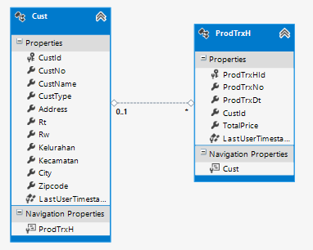
Entity Data Model
The Entity Data Model (EDM) is a set of concepts that describe the structure of data, regardless of its stored form.

Slide 10


EDMX
Step Pre-Generated Views
Select EDMX to generate.
Right-click on EDMX – Properties – Metadata Artifact Processing: Copy to Output Directory
Right-click on project Confins.DataModel – Properties
Tab Build – PreBuild
Tab Build – Post Build

Slide 11
Build Project
Right-Click on Confins.DataModel – Add Existing Item
Add this file contained in folder Confins.DataModel
MiscEntitiesSQL.csdl
MiscEntitiesSQL.msl
MiscEntitiesSQL.ssdl
MiscEntitiesSQL.Views.cs
Right-Click on this file – Properties – Build Action: Embedded Resource
MiscEntitiesSQL.csdl
MiscEntitiesSQL.msl
MiscEntitiesSQL.ssdl
Build Project
If it is successful, delete script generate from poco.

Slide 12
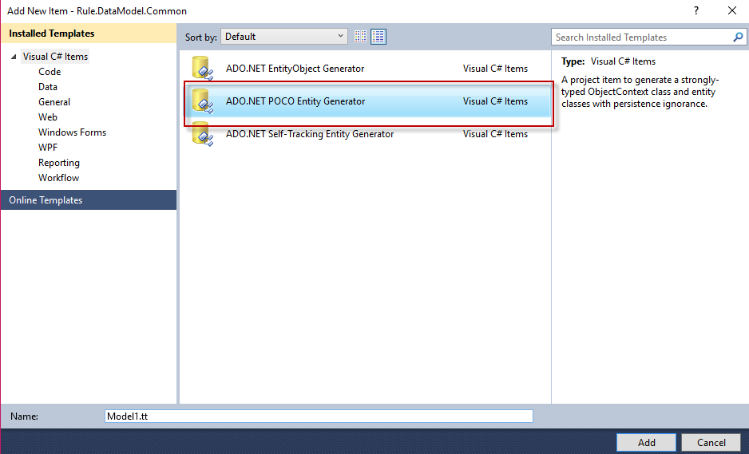
POCO (Plain Old CLR Object)
is a simple object created in the Common Language Runtime (CLR) of the .NET Framework which is unencumbered by inheritance or attributes
Normally when we use entity framework the entities are generated automatically for you
Notes:
Logika domain?
Logika persistensi?
https://aiskahendra.wordpress.com/

Slide 13
Using Transaction
Business Interface
The business object can be created from local server or remote server, thus the business interface is as a contract that the caller can communicate with it
Business Logic
Represents as a business component that doing business logic or business rule

Slide 14
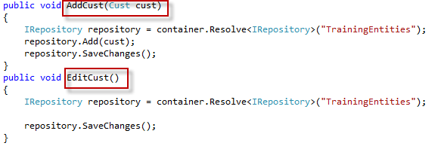
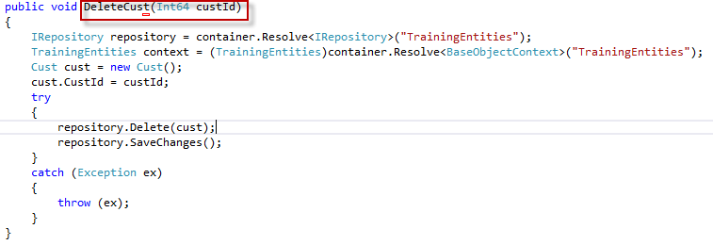
Function Name

Slide 15
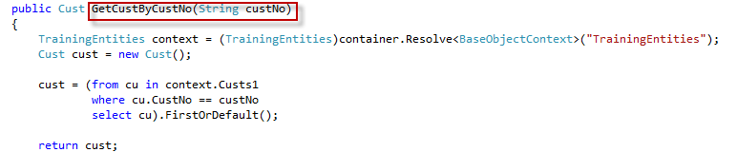
Function Name(2)

Slide 16
Exercise

Slide 17
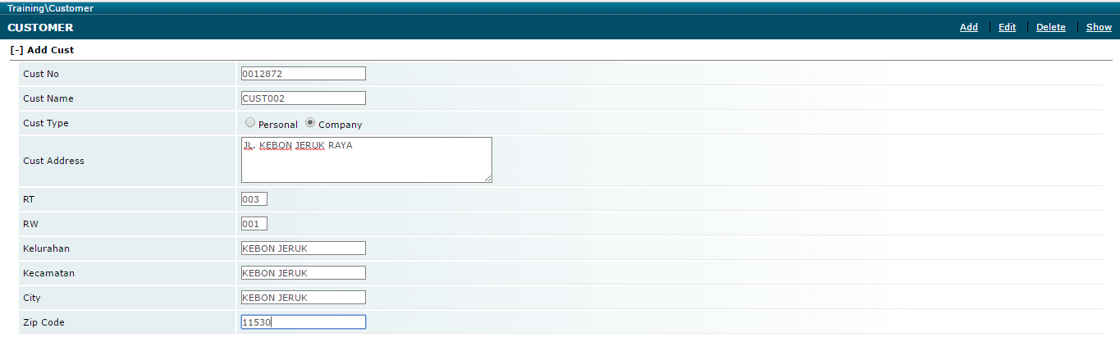
Create Add,Edit,Delete Menu

Slide 18
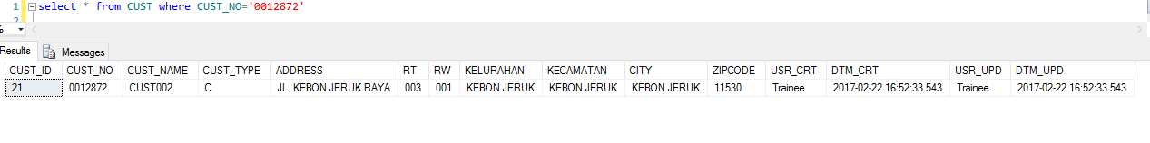
Click Button Add
Save Database

Slide 19
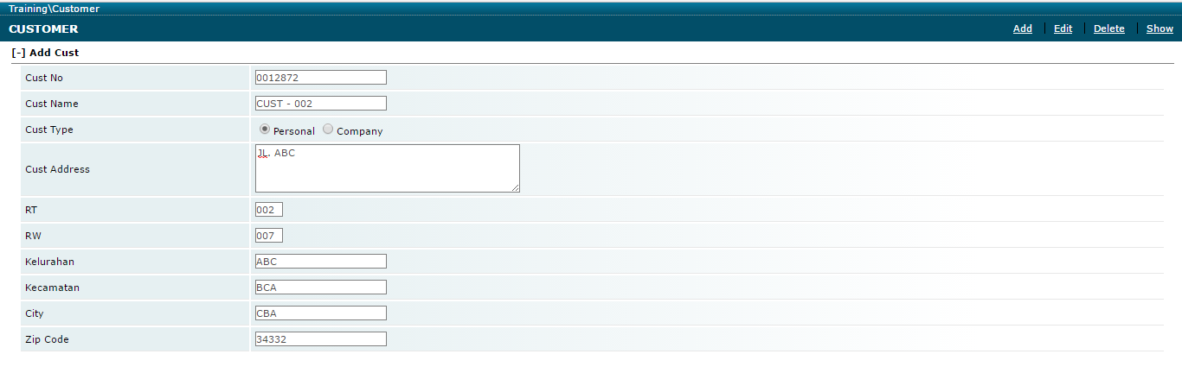
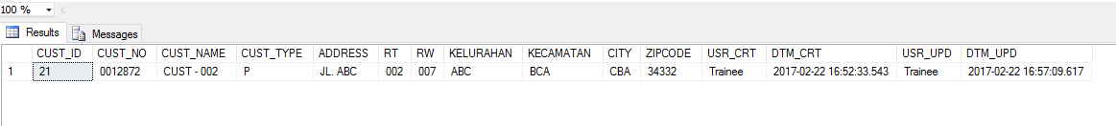
Click Button Edit
Save Database

Slide 20
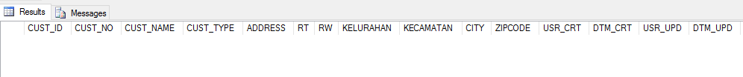
Click Button Delete
Empty Data in Database

Slide 21
Thank You

